Slide 1
109 Data Structure Programming Examination

Slide 2
Question Set - 1
Spot the liars (20%)
Surmount the Pyramid (80%)
A Simple 3D Maze (20%)
A Dangerous Pyramid (30%)
An Amazing Secret (30%)

Slide 3
Spot the liars (20%)
Your army caught some prisoners of war. Most of them are still loyal to the enemy. However, some of them WERE loyal to the enemy.
Now, they point each other and say he/she is a liar. You need to figure out who is trying to tell the truth.

Slide 4
Spot the liars (20%)
For each input:
Line 1: An integer N for the number of prisoners. (1 < N < 21)
Line 2: An integer M for the number of liars. (0 < M < N)
Next N lines: A string allegation indicates what the prisoner said.
An allegation is like: NO>NO>NO...=[T/L]
The number of “>” is less than 600.
You can translate the allegation by:
NO told that NO told me that NO...NO is telling the truth/lying.
The liars always lie, the others always tell the truth.
output: Who is/are the liar(s)?

Slide 5
Spot the liars (20%)
For example:
3
2
0>1>2>1>0>2=T
1>2>0=T
2>0>1>2=T
output: 0 1

Slide 6
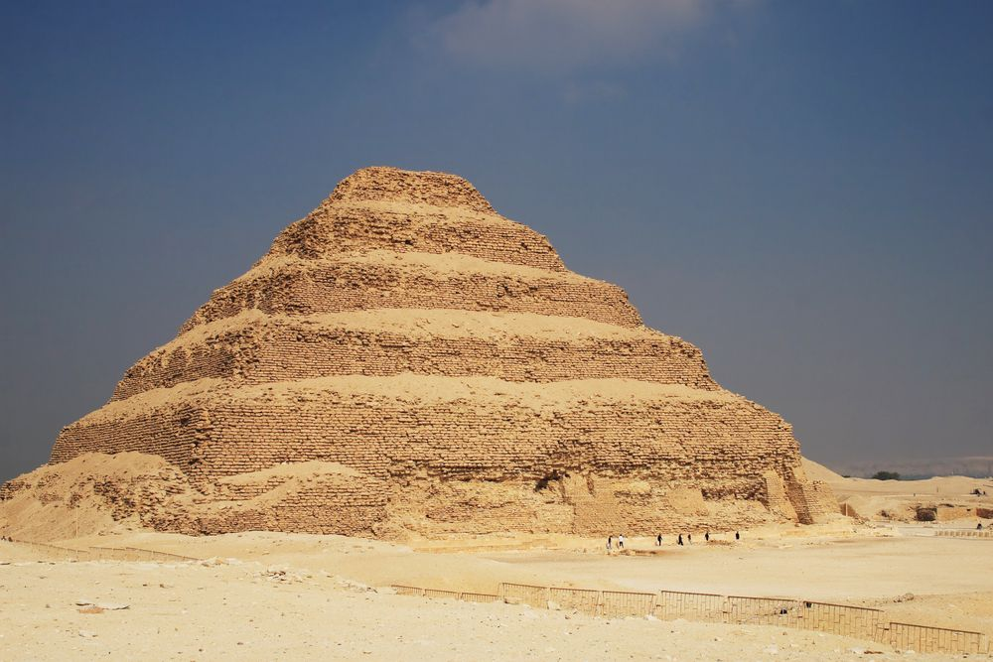

Surmount the Pyramid (80%)
“There are only two creatures who can surmount the pyramids--the eagle and the snail.”
The snail enters a pyramid from the bottom of the pyramid. Its goal is to go to the top of the pyramid.

Slide 7
A Simple 3D Maze (20%)
Input:
N is the size of the 1st floor of the pyramid. (N is odd)
There will be k (k = N//2 + 1) floors in the pyramid.
The first N lines: N characters separated by spaces indicate the content of the 1st floor.
The next N-2k lines: N-2k characters separated by spaces indicate the content of the (k-1)^{th} floor.
When k = N//2+1, a character F indicates the endpoint. (The top floor of the pyramid.)

Slide 8
A Simple 3D Maze (20%)
Characters:
O: You may pass through this way
X: Wall. You can’t pass through this way
S: Start point (exist for sure)
F: End point (in the top floor of the pyramid for sure)
U: You can go to the upper layer of the pyramid here.
You can also walk through like this is an O character.
D: You can go to the lower layer of the pyramid here.
You can also walk through like this is an O character.
T: Trap, the snail needs 3 steps to pass here.

Slide 9
A Simple 3D Maze (20%)
Six directions: NESW and up/down.
1 cost per movement in {O, U, D, S, F}.
1) Find out the shortest path from S to F and print the output graph. (30%)
The size of the 1st floor of the pyramid is N.
2<N<8 for the first question.

Slide 10
A Simple 3D Maze (20%)
The blue characters indicate the range of the upper layer
S O O O O
O O O O O
O O O O O
O U O O O
O O O O O
O O O
O U O
O O O
F

Slide 11
A Simple 3D Maze (20%)
Path Length: 8
* * O O O
O * O O O
O * O O O
O * O O O
O O O O O
O O O
* * O
* O O
*

Slide 12
A Simple 3D Maze (20%)
For the 1st question.
Input files are testi.txt, i∈{1,2,...,5}.
When scanning files, please inform me in the prompt.
Please output the corresponding testi_ans.txt, i∈{1,2,...,5}
Time Limit: 8 seconds per data

Slide 13
A Dangerous Pyramid (30%)
There are so many traps in the pyramid. The snail has to overcome them carefully.
Six directions: NESW and up/down.
1 cost per movement in {O, U, D, S, F}.
3 cost per movement in T.
2) In the weighted maze, find out the shortest path from S to F and print the output graph. (30%)
2<N<15 for the rest of the questions.

Slide 14
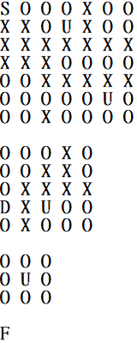
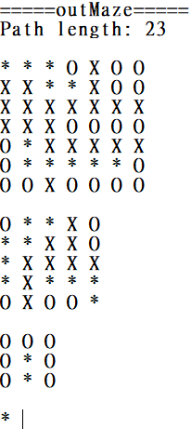
A Dangerous Pyramid (30%)
example :

Slide 15
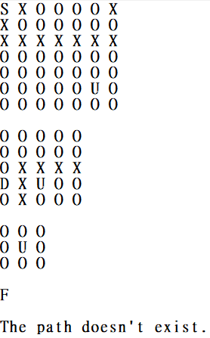
A Dangerous Pyramid (30%)
example :

Slide 16
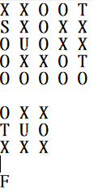
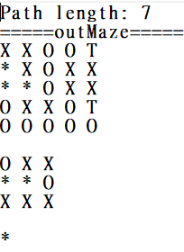
A Dangerous Pyramid (30%)
example :

Slide 17
A Dangerous Pyramid (30%)
For the 2nd question.
Input files are testi.txt, i∈{1,2,...,5}.
When scanning files, please inform me in the prompt.
Please output the corresponding testi_ans.txt, i∈{1,2,...,5}
Time Limit: 8 seconds per data

Slide 18
An Amazing Secret (30%)
The snail heard there’s an amazing secret in a certain road. It needs to find out no matter how.
4) You need to go to the endpoint while passing a specified path. Print the length of the shortest path and the number of all possible paths. (20%)
There will be some characters P in the maze. You need to pass through the path formed by P then reach the endpoint.
You can go upper/lower layer in P.

Slide 19
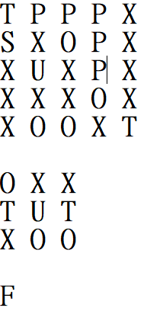
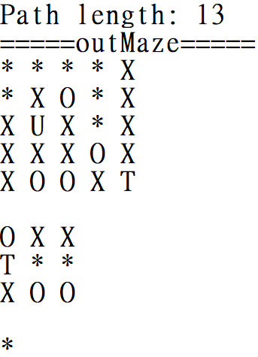
An Amazing Secret (30%)
Example (no need output graph in this question) :
The number of the paths : 2

Slide 20
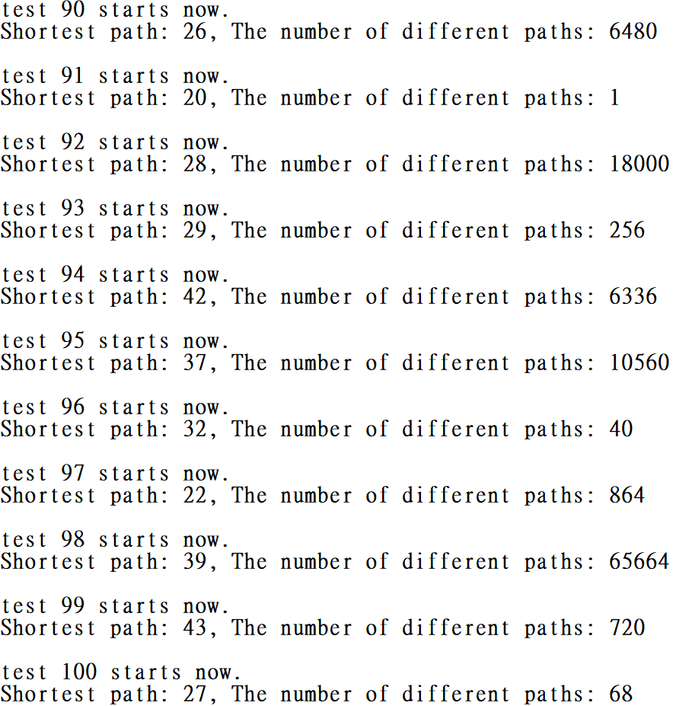
An Amazing Secret (30%)
Example of the output.txt:

Slide 21
An Amazing Secret (30%)
For the 4th question.
Input files are testi.txt, i∈{1,2,...,5}.
When scanning files, please inform me in the prompt.
Please output the corresponding output.txt.
Time Limit: 8 seconds per data

Slide 22
Question Set - 2
Operation Overlord (50%)
Set the Allies’ bases optimally - I (25%)
Set the Allies’ bases optimally - II (25%)
Trolley Problem (50%)
Setting Environment (10%)
Optimize the Process (40%)

Slide 23
Operation Overlord (50%)
Operation Overlord was the codename for the Battle of Normandy.
On Tuesday, 6 June 1944, the Allies invaded Normandy, which was under German control at that time.
It was the largest seaborne invasion in history.

Slide 24
Operation Overlord (50%)
The Allies successfully landed after paying a huge price.
From then on, the Allies needed to establish a secure lodgement from which to expend the beachhead to allow the buildup of a well-supplied force.
Assume that you were the commander during the war. Helping the Allies make a detailed plan was your job.

Slide 25
Operation Overlord (50%)
1) Set the Allies’ bases optimally (25%)
You think you may treat the Omaha Beach, which was the code name for one of the five sectors of the invasion, as a root.
The Allies may expand bases with a tree-like structure.
To simplify this problem, you may treat the tree-like structure as a binary tree.
Each base may guard its parent, itself, and its two child nodes.

Slide 26
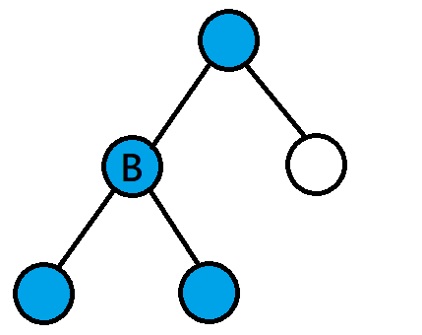
Operation Overlord (50%)
For example, you build a base in the node B, the blue nodes will be secured.
You need to build the least base while making sure every lodgements are secured.

Slide 27
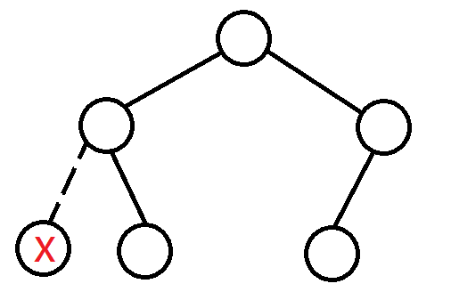
Operation Overlord (50%)
input: [0,0,0,null,0,0] (The X node doesn’t exist.)
output: 2
You may assume you can construct a valid tree with the input.

Slide 28
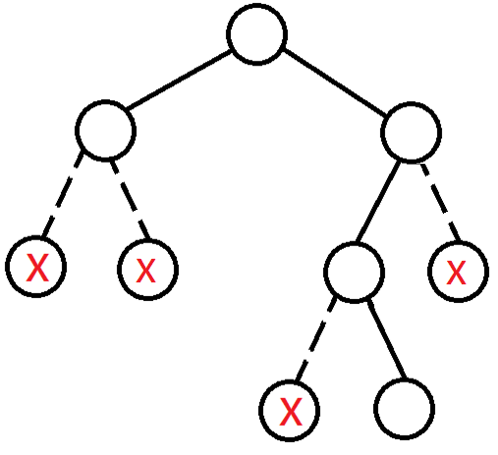
Operation Overlord (50%)
input: [0,0,0,null,null,0,null,null,0] (The X node doesn’t exist.)
output: 2

Slide 29
Operation Overlord (50%)
/*struct TreeNode {
int data;
struct node* left;
struct node* right;
}; */
There will be no limit for this problem, you only need to print out the answer.

Slide 30
Operation Overlord (50%)
2) Set the Allies’ bases optimally - II (25%)
You first make a rough plan. However, the battlefield cannot be treated as such a simple scene.
You next consider the enemies. Some places may not be conquered so easily.
However, you may build up your base next to it and nibble them slowly.
What you need to do is to calculate how to pare down our expenses to a bare minimum.

Slide 31
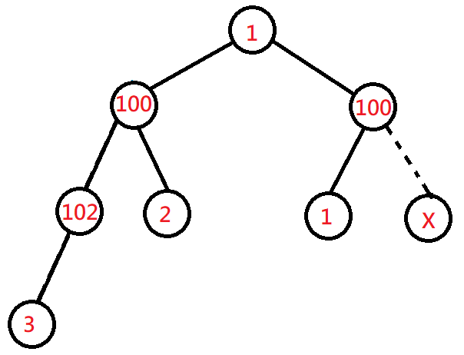
Operation Overlord (50%)
The data field stored in a TreeNode indicates the cost for building a base there.
input: [1,100,100,102,2,1,null,3] (The X node doesn’t exist.)
output: 7 (1+2+1+3)

Slide 32
Operation Overlord (50%)
For both of the problems:
The number of nodes in the tree is N.
0 <= N <= 15000
Time limit: 1 second per data.
1st problem
TreeNode.data = 0
2nd problem
0 <= TreeNode.data <= 1000

Slide 33
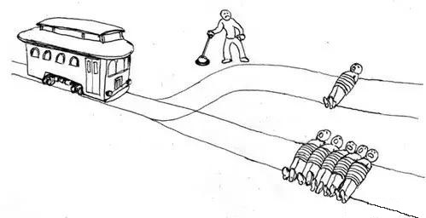
Trolley Problem (50%)
Trolley problem is a classical thought experiment in psychology. The basic version goes thus:
There are two tracks. There are 5 people tied up on one of both while there is 1 person tied up on the other.
A trolley is running straight for the 5-person one, You have two options:
Do nothing and allow the trolley to kill the five people on the main track.
Pull the lever, diverting the trolley onto the side track where it will kill one person.
Which is the more ethical option? Or, more simply: What is the right thing to do?

Slide 34
Trolley Problem (50%)
You got caught by The Jigsaw Killer. He wants to play a game. You have to make a choice.
Luckily, it is not such a hard problem to judge. There is always one track which is able to pass. Thus nobody will die.
You only need to choose the right one as soon as possible.

Slide 35
Trolley Problem (50%)
1) Build a data structure, which indicates the platforms of a trolley station. (10%)
There are 20 platforms.
You switch the platform you control with your joystick.
The last platform is connected to the first platform, creating a loop.
The target station of the platforms are initialized as “ “.
Commands:
>: Switch to the platform on the right.
<: Switch to the platform on the left.
+: Change the target station of the platform with “plus 1”.
-: Change the target station of the platform with “minus 1”.
The target station of the platforms can be: {(space), A, B, …, Z}.
The station after Z is space. The station after space is A.
Please treat “ “ as a valid input.
.: Trolley departs from the platform to the target station under control.

Slide 36
Trolley Problem (50%)
For example:
input:
output:
+
.
+
+
.
.
+
+
+
+
+
+
.
+
+
+
+
+
+
.
A
C
C
I
O
D
C
A
G
F
E
B
H
M
K
J
L
N
I
O

Slide 37
Trolley Problem (50%)
2) Try to optimize the process. (40%)
Time limit: 3 seconds per input.
After all the strings’ inputted are handled, I’ll sum up all your output strings’ length and compare with my algorithm.
You will get different grades if the sum of your lengths are:
10% : 100% longer than the length of my algorithm.
20% : 50% longer than the length of my algorithm.
30% : 5% longer than the length of my algorithm.
40% : the length is [-100%..5%] of my algorithm.
Note: We’ll score only when you can correctly output all the answers.

Slide 38
Trolley Problem (50%)
EXPELLIARMUS
output: +++++.>---.--------.<.>----..---.>+.<+++++++++.-----.++++++++.--.
(The animation only demonstrates the part of “EXPELLIA”)
A
B
C
D
E
Z
Y
X
W
V
U
T
S
R
Q
P
O
N
M
L
K
J
I
A

Slide 39
Question Set - 3
A Sad Teaching Assistant (40%)
A Simple Task (20%)
The Second Mission (20%)
Morse Code (60%)
English to Morse Code (15%)
Prefix of Morse sequence (15%)
Decode the Document - easy case (15%)
Decode the Document - complex case (15%)

Slide 40
A Sad Teaching Assistant (40%)
There’s a teaching assistant for a data structure course in a university.
One day, the students told him that the homework he proposed is an algorithm-like homework. It’s not a homework for a data structure course.
He was depressed. Thus, he decides to propose a homework which is really associated to data structure.
Finally, the TA I just talked about is not me.

Slide 41
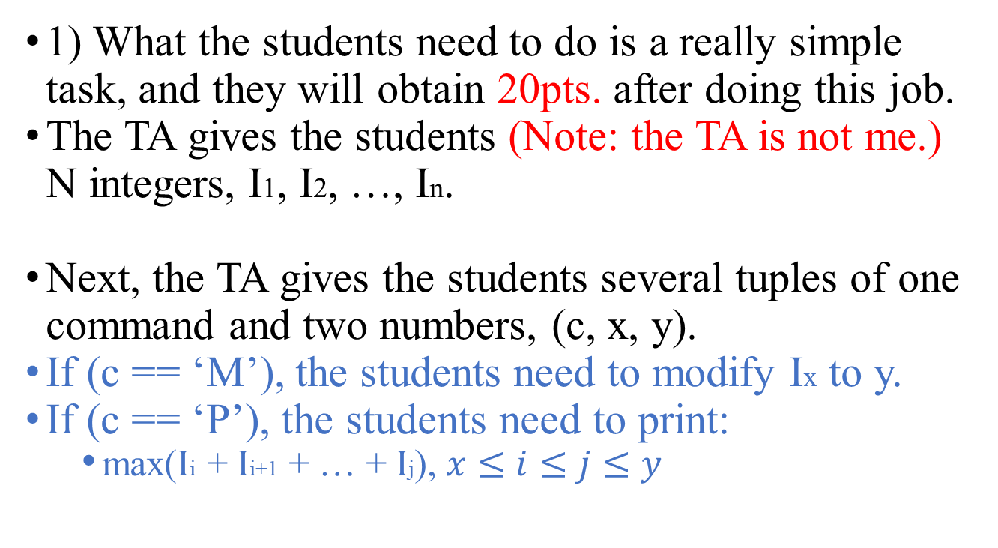
A Sad Teaching Assistant (40%)
1) What the students need to do is a really simple task, and they will obtain 20pts. after doing this job.
The TA gives the students (Note: the TA is not me.) N integers, I1, I2, …, In.
Next, the TA gives the students several tuples of one command and two numbers, (c, x, y).
If (c == ‘M’), the students need to modify Ix to y.
If (c == ‘P’), the students need to print:
max(Ii + Ii+1 + … + Ij), $x≤i≤j≤y$

Slide 42
A Sad Teaching Assistant (40%)
Input:
Line 1: An integer T, indicates how many times the task will be asked for.
Line 2: An integer N, indicates the number of the integers TA will give.
Line 3: N integers, I1, I2, …, IN, indicate the initial numbers.
Line 4: An integer M.
Next M lines: C x y tuples
Output:
For each P x y tuple, you need to print
max(Ii + Ii+1 + … + Ij)

Slide 43
A Sad Teaching Assistant (40%)
For example:
1 (T)
5 (N)
1 2 -100 3 4
5 (M)
P 1 5 // print 7 (3+4 = 7)
P 1 2 // print 3 (1+2 = 3)
M 3 5 // modify the integers into 1 2 5 3 4
P 1 5 // print 15 (1+2+5+3+4 = 15)
P 2 4 // print 10 (2+5+3 = 10)
output : 7\n3\n15\n10\n (\n : EOL)

Slide 44
A Sad Teaching Assistant (40%)
For this problem:
The times of the task might be asked for is T.
1 <= T <= 5
The number of integers given is N.
1 <= N <= 50000
The given integers are [-10000, 10000]
The number of command tuples given is M.
1 <= M <= 50000
Time limit: 2 second per data.

Slide 45
A Sad Teaching Assistant (40%)
Hint: You should make sure every command could work within time complexity O(log n).

Slide 46
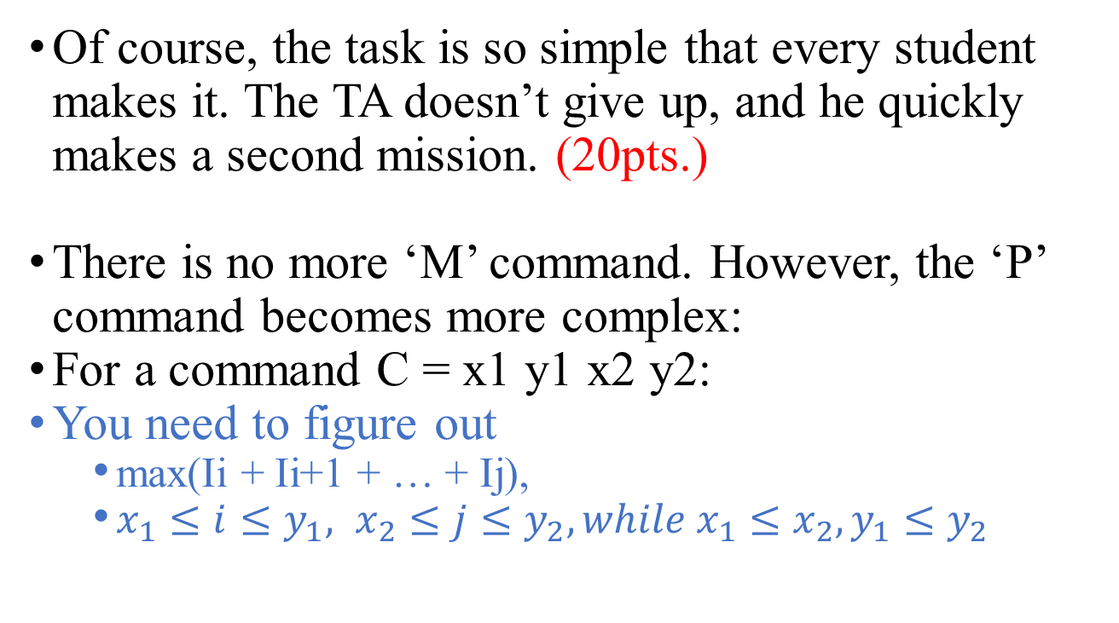
A Sad Teaching Assistant (40%)
Of course, the task is so simple that every student makes it. The TA doesn’t give up, and he quickly makes a second mission. (20pts.)
There is no more ‘M’ command. However, the ‘P’ command becomes more complex:
For a command C = x1 y1 x2 y2:
You need to figure out
max(Ii + Ii+1 + … + Ij),
$x_{1}≤i≤y_{1}, x_{2}≤j≤y_{2}, while x_{1}≤x_{2},y_{1}≤y_{2}$

Slide 47
A Sad Teaching Assistant (40%)
Input:
line 1: An integer T, indicates how many times the task will be asked for.
line 2: An integer N, indicates the number of the integers TA will give.
line 3: N integers, I1, I2, …, IN, indicate the initial numbers.
line 4: An integer M.
next M lines: x1 y1 x2 y2 tuples.
Output:
For each P x y tuples, print
max(Ii + Ii+1 + … + Ij)

Slide 48
A Sad Teaching Assistant (40%)
For example:
2 (T)
6 (N)
5 -9 -5 9 -3 4
3 (M)
1 3 6 6 // print 5 ((-5) + 9 + (-3) + 4 = 5)
1 2 3 6 // print 1 (5 + (-9) + (-5) + 9 + (-3) + 4 = 1)
4 4 6 6 // print 10 (9 + (-3) + 4 = 10)
6 (N)
-2 -7 8 9 9 -5
1 (M)
6 6 6 6 // print -5 ((-5) = (-5))
output : 5\n1\n10\n-5\n (\n : EOL)

Slide 49
A Sad Teaching Assistant (40%)
For this problem:
The task will be asked for T times.
1 <= T <= 5
The number of given integers is N.
1 <= N <= 10000
The given integers are [-10000, 10000]
The number of given command tuples is M.
1 <= M <= 10000
Time limit: 2 second per data.

Slide 50
Morse Code (60%)
Morse code is a method used to encode text characters as sequences of dots and dashes.
字元 | 代碼 | 字元 | 代碼 | 字元 | 代碼 | 字元 | 代碼
A | .- | H | .... | O | --- | V | ...-
B | -... | I | .. | P | .--. | W | .--
C | -.-. | J | .--- | Q | --.- | X | -..-
D | -.. | K | -.- | R | .-. | Y | -.--
E | . | L | .-.. | S | ... | Z | --..
F | ..-. | M | -- | T | -
G | --. | N | -. | U | ..-

Slide 51
Morse Code (60%)
You receive confidential documents. Your supervisor used Morse code to encode the contents.
However, there are no spaces separating the letters in the documents.
Therefore, there may be several interpretations of any single decoded sequence.
For example:
“-....--.-.” could be: “DUC”, “DUTETE”, “BAC”, “BANN”, ...

Slide 52
Morse Code (60%)
You try to decode the contents of the documents. Because there are too many documents, you decide to write a program to help you.
It’s hard for a machine to recognize which interpretation is reasonable. Thus, you use a dictionary to support this task.
Note: If you can make 2-3 perfectly, you may get all the 60 pts. without doing 2-1 and 2-2.

Slide 53
Morse Code (60%)
1) English dictionary to Morse code. (15%)
Input:
line 1: An integer N, indicates the number of words in the dictionary.
next N lines: A word.
line N+2: An integer M.
next M lines: a sequence of dots and dashes.
Output:
For each sequence, you need to print:
It is found in the dictionary.
It is not found in the dictionary.

Slide 54
Morse Code (60%)
For example:
4 (N)
APPLE // .-.--..--..-...
BANANA // -....--..--..-
CAT // -.-..--
DOG // -..-----.
2 (M)
-.-..-- //printf(“-.-..-- is found in the dictionary.\n”)
-.- //printf(“-.- is not found in the dictionary.\n”)

Slide 55
Morse Code (60%)
2) Determine if two words have the same prefix. (15%)
Input:
line 1: A word w1.
line 2: An integer N.
next N lines: A word w2.
Output:
For each w2, you need to determine:
After w1, w2 are both encoded into Morse code:
w2 is the same as w1.
w2 has the same prefix as w1.
w2 is not a prefix of w1.

Slide 56
Morse Code (60%)
For example:
CAT (w1) // -.-..--
3 (M)
NDTT // -.-..--
KIT // -.-..-
RUT // .-...--
output:
“NDTT is the same as CAT.”
“KIT has the same prefix as CAT.”
“RUT is not a prefix of CAT.”

Slide 57
Morse Code (60%)
3) With the dictionary and the program, you only need to check the part of the interpretations. (30%)
Input:
line 1: A Morse sequence with a maximum length L.
line 2: An integer N indicates the number of words in the dictionary.
next N lines: One word.
Output:
The number of messages R, which are possible to generate with the Morse sequence and the dictionary.

Slide 58
Morse Code (60%)
For example:
......-...-..---.-----.-..-..-..
5
HELL // ......-...-..
HELLO // ......-...-..---
OWORLD // ---.-----.-..-..-..
WORLD // .-----.-..-..-..
TEST // -....-
output: 2 (HELL+OWORLD, HELLO+WORLD)

Slide 59
Morse Code (60%)
The Morse sequence has a maximum length L.
0 < L < 100000
The number of words in the dictionary is N.
0 < N < 100000
The words in the dictionary have a maximum length M.
0 < M < 20
Time limit: 2 second per data.

Slide 60
Question Set - 3
A Sticky Safe Lock (30%)
Haunted Mansion (40%)
Baba is You (30%)

Slide 61
A Sticky Safe Lock (30%)
There is a locked safe in front of you. You know the 4-digit password of its password lock.
Unfortunately, the password lock on it is sticky. When you rotate one of the dials, the dials next to it will also be turned.
Moreover, there are a note and a set of forbidden password on the lock: “If you rotate the dials casually, the safe will explode.”
You decide to write a program to solve this problem.

Slide 62
A Sticky Safe Lock (30%)
Input:
Line 1: 4 integers indicate the digits on the password lock now, separated with space.
Line 2: 4 integers represent the password, separated with space.
Line 3: An integer N.
Next N lines: The forbidden password.
The sequence of your steps should not contain the password in the set.
Output:
Line 1: An integer M indicates the shortest step.
Next M lines: The sequence of the steps.
Or
Line 1: “Impossible” if the explosion can’t be avoided.

Slide 63
A Sticky Safe Lock (30%)
For example:
0 0 0 0
0 0 0 1
2 (N)
1 1 0 0
0 0 1 1
Output:
3 (M)
9990
0090
0001

Slide 64
A Sticky Safe Lock (30%)
For this problem:
There are 4 digits on the lock.
The digits of the password can be [0..9]. 0 is after 9, and 9 is before 0.
The number of the forbidden password is N.
0 ≤ N ≤ 9999
Time Limit: 2 seconds.

Slide 65
Haunted Mansion (40%)
There’s a haunted mansion. Your scouts report you the message of the mansion. You need to figure out the information about the monsters.
However, there are mirrors in the mansion. Moreover, each kind of the monsters has a different property about the mirrors.
You need to consider both of the mirrors and the properties of the monsters, then find out the most reasonable information.

Slide 66
Haunted Mansion (40%)
Input:
Line 1: 3 Integers Vcount, Zcount, Gcount indicate the number of each type of monster in the grid.
Line 2: An integer N indicates the size of the manor.
Next 4 lines: N integers represent the number of visible monsters from
top of the grid, from left to right.
bottom of the grid, from left to right.
left of the grid, from top to bottom.
right of the grid, from top to bottom.
Next N lines: N characters. ‘.’ indicates a monster in the grid, and ‘/’, ‘\’ indicate a mirror in the grid.

Slide 67
Haunted Mansion (40%)
Output:
N lines: N characters.
The lines represent the whole manor.
The character will be
V for a vampire
Z for a zombie
G for a ghost
/ or \ for a mirror.
You can’t see a vampire through a mirror.
You can see a zombie directly or through a mirror.
You can see a ghost ONLY through a mirror.

Slide 68
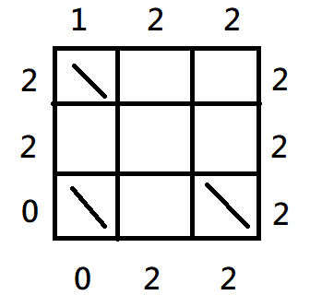
Haunted Mansion (40%)
For example:
Input:
1 3 2 // Vcount, Zcount, Gcount
3 (N)
1 2 2
0 2 2
2 2 0
2 2 2
\..
...
\.\

Slide 69
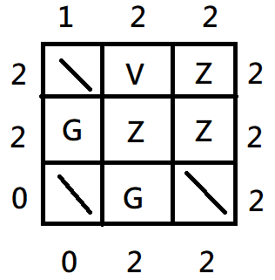
Haunted Mansion (40%)
For example:
1 3 2 (Vcount, Zcount, Gcount)
Output:
\VZ
GZZ
\G\

Slide 70
Haunted Mansion (40%)
For this problem:
The size of the manor is N.
0 ≤ N ≤ 7
0 ≤ Vcount ≤ N
0 ≤ Zcount ≤ N
0 ≤ Gcount ≤ N
Time Limit: 2 seconds.

Slide 71

Baba is You (30%)
Independent Game Festival (IGF) is an annual event. The game “Baba is you” won the 2018 “Excellence in Design” and “Best Student Game” Awards.
In the game, the logic is according to a block connected to the other block.
You control things that “IS YOU”.
The only goal of the game is let “YOU” reach “WIN”.

Slide 72
Baba is You (30%)
In this puzzle, I’ll give you a set of universal truths, you need to determine whether
All pigs can fly.
Some pigs can fly.
No pigs can fly.

Slide 73
Baba is You (30%)
Each of the input sentences contains a logical statement in the general form:
ObjectA (are ObjectB | have Trait | can Ability)
or TraitA are TraitB
Furthermore, objects can be expanded to:
Object [with TraitA [and TraitB ...]] [that can AbilityA [and AbilityB ...]]
MICE are RODENTS
MICE have WINGS
MICE that can FLY are ANIMALS with SUPERPOWERS

Slide 74
Baba is You (30%)
For example:
1)MICE are RODENTS
2)MICE with WINGS are BATS
3)MICE that can FLY are ANIMALS with SUPERPOWERS
4)BATS are RODENTS
5)RODENTS with FEET and NOSES that can EAT are POPSICLES
To clarify, statement 1 means that all MICE are RODENTS, but only some RODENTS are MICE.
It cannot be assumed from statement 1 and 4 that some MICE are BATS.

Slide 75
Baba is You (30%)
The other examples:
1) CHICKENS with BEAKS are LLAMAS with MOUTHS
2) CHICKENS have BEAKS
Some LLAMAS with MOUTHS have BEAKS.
All CHICKENS are LLAMAS with MOUTHS.
1) CHICKENS with BEAKS are LLAMAS with MOUTHS
2) CHICKENS have BEAKS and EYES
Some LLAMAS with MOUTHS have EYES (and BEAKS).
All CHICKENS are LLAMAS with MOUTHS.

Slide 76
Baba is You (30%)
For all the inputs, print “No/Some/All pigs can fly.” (30%)
Line 1: An integer N represents the number of logical statements.
Next N lines: A logical statement.
output: “All/Some/No pigs can fly.”

Slide 77
Baba is You (30%)
For example (green sentences are results):
3
PIGS are BACONS
BACONS are GODS
(Thus, All PIGS are GODS)
GODS can FLY
output: All pigs can fly

Slide 78
Baba is You (30%)
7
GEESE are CHICKENS with BEAKS
BEAKS are TOENAILS
CHICKENS with BEAKS are LLAMAS with MOUTHS
CHICKENS have EYES
(All GEESE are LLAMAS with MOUTHS and EYES and TOENAILS and BEAKS)
CHICKENS with EYES and TOENAILS are TREES that can FLY
(All GEESE are CHICKENS with EYES and TOENAILS)
→ (All GEESE are TREES that can FLY)
LLAMAS with TOENAILS are PIGS
PIGS are TREES that can WALK
(All GEESE are PIGS, All GEESE are TREES that can FLY)
(Some PIGS are GEESE)
output: Some pigs can fly

Slide 79
Baba is You (30%)
For this problem:
The number of the statements is N.
2 ≤ N ≤ 15
The length of the a statement is L.
1 ≤ L ≤ 256
“PIGS” exists in 1 or more statements for sure.
“FLY” exists in 1 or more statements for sure.
Object, Trait, Ability are written in uppercase, and everything else is in lowercase.
Time Limit: 2 seconds.

